Slide 1


Introduction to uClinux
Introduction to uClinux
Michael Opdenacker
Free Electrons
http://free-electrons.com
V M
Created with OpenOffice.org 2.x
Thanks to Nicolas Rougier (Copyright 2003, http://webloria.loria.fr/~rougier/) for the Tux image

Slide 2




Rights to copy
Attribution – ShareAlike 2.5
You are free
to copy, distribute, display, and perform the work
to make derivative works
to make commercial use of the work
Under the following conditions
Attribution. You must give the original author credit.
Share Alike. If you alter, transform, or build upon this work, you may distribute the resulting work only under a license identical to this one.
For any reuse or distribution, you must make clear to others the license terms of this work.
Any of these conditions can be waived if you get permission from the copyright holder.
Your fair use and other rights are in no way affected by the above.
License text: http://creativecommons.org/licenses/by-sa/2.5/legalcode
© Copyright 2004-2008
Free Electrons
feedback@free-electrons.com
Document sources, updates and translations: http://free-electrons.com/articles/uclinux
Corrections, suggestions, contributions and translations are welcome!

Slide 3
Best viewed with...
This document is best viewed with a recent PDF reader
or with OpenOffice.org itself!
Take advantage of internal or external hyperlinks.
So, don’t hesitate to click on them!
Find pages quickly thanks to automatic search.
Use thumbnails to navigate in the document in a quick way.
If you’re reading a paper or HTML copy, you should get your copy in PDF or OpenOffice.org format on http://free-electrons.com/articles/uclinux!

Slide 4
Contents
uClinux project overview
uClinux implementation details
Using uClinux

Slide 5
Acronyms
MMU: Memory Management Unit
MPU: Memory Protection Unit
Only implements memory protection, not virtual memory.
GOT: Global Offset Table - Used in executable formats.
ELF: Executable and Linkable Format
A file format describing executables, object code, shared libraries and core dumps. The OS uses it to know how to load executables and shared libraries.
PIC: Position Independent Code
Object code without absolute addresses, which can execute at different locations in memory.
See http://en.wikipedia.org/wiki/Position_independent_code

Slide 6
The MMU job
MMUs included in many general purpose processors available today
Virtual to physical address translation.
Allows processes to run in their own virtual contiguous address space. No need for relocating process addresses. Possible to expand the address space of a running process.
The MMU raises an exception when no physical address is available, making it possible to implement swapping to disk.
Address protection
Actually done by the MPU available in most MMUs.
Prevents processes from accessing unauthorized memory addresses.
This is also used to implement demand paging (using page faults to load in RAM only the addresses actually accessed) and swapping.
Note that some systems just have an MPU, but no MMU.

Slide 7
Introduction to uClinux
uClinux project overview

Slide 8

The uClinux project
http://www.uclinux.org/ - Linux for micro-controllers
Deliveries:
Linux kernel supporting MMU-less processors
(at least 32 bit) Supported in mainstream sources
or through patches.
Software distribution (source only):
http://www.uclinux.org/pub/uClinux/dist/
uClibc: a lightweight though highly compatible C library.
Now an independent project. Used by Linux too!
Cross-compiling toolchains.

Slide 9
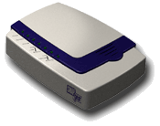

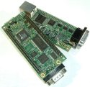

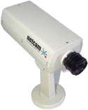

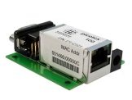
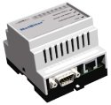


uClinux devices
Tiny Single Board
Computers
Network devices
Just a few examples!
Send us more!
uClinux is often so deeply embedded
that it's difficult to identify
C Data Solutions
CF computer
SnapGear LITE2 VPN/Router
Multimedia
Simtec SBCs
Industrial
picotux RJ45 size
computer
StarDot NetCam
Apple iPod (not shipped with uClinux)
Sigma Designs EM8500 based DVD players
IntelliCom remote control system
Aplio/PRO IP Phone

Slide 10
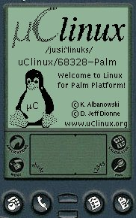
uClinux history
First release in 1998 (Linux 2.0),
for the Motorola 68000 processor.
Demonstrated on Palm Pilot III.
1999: Motorola ColdFire support
2001: Linux 2.4 support. ARM7 support
2004: Linux 2.6 support for ARM
2008: You're reading this document

Slide 11
Reasons for using uClinux (1)
Linux
Built-in IP connectivity, reliability, portability, filesystems, free software...
Lightweight
Full Linux 2.6 kernel under 300K, binaries much smaller with uClibc.
XIP (Execute In Place)
Don't have to load executables in RAM. May run slower though.
Cheaper
MMU-less arm cores are smaller.
Sufficient
A large number of embedded systems applications can do without an MMU.
Faster
Faster context switches: no cache flushes.

Slide 12
Reasons for using uClinux (2)
User access to the hardware
User applications can access the whole system, including device registers.
Full Linux API
Can use most Linux system calls with minor exceptions. Ported applications distributed with uClinux.
Full Linux 2.6 kernel features
stability, preemptible kernel, drivers...
Full multi-tasking
Just minor limitations
Supported on many processors, which wouldn't be supported by Linux otherwise.
See http://www.uclinux.org/ports/
Even running on DSP processors
(ADI Blackfin, TI DM64x)!

Slide 13
uClinux weaknesses
Less momentum than Linux.
Much smaller community.
Much less on-line documentation
and resources available
Lack of updates on pages and deliverables on http://uclinux.org. Lots of links and resources older than 2002.
Lots of projects still using Linux 2.4.
However uClinux development is still active: kernel and distribution.
uClinux releases available for each Linux 2.6.x version,
released just a few weeks after.

Slide 14
uClibc
http://www.uclibc.org/ for CodePoet Consulting
Lightweight C library for small embedded systems, with most features though.
Originally developed for uClinux. Now an independent project.
The whole Debian Woody (thousands of programs) was recently ported to it... You can assume it satisfied most needs!
Example size (ARM): approx. 400K (vs. 1700 K for glibc)
uClibc vs. glibc size comparison (busybox example, static build):
311 K vs. 843 K!

Slide 15
uClinux limitations
In a nutshell
Virtual memory = physical memory
Fixed memory for processes, can't fragment the memory: more memory consumption
No memory protection. No distinction between user mode and kernel mode. Any program can corrupt kernel memory and even cause a system crash.
Very useful details (by David McCullough):
http://www.linuxjournal.com/article/7221

Slide 16
Introduction to uClinux
uClinux implementation details

Slide 17
No memory management
No virtual memory
Programs addresses need to be preprocessed (“relocated”) before running to obtain unique address spaces.
No on-demand paging
Need to load whole program code in RAM
(instead of just loading pages when they are effectively accessed).
No memory protection
Any program can crash another program or the kernel. Corruption can go unnoticed and surface later... difficult to track down! Design your code carefully. Be careful of data from the outside!
No swapping
Not really an issue on the tiny embedded devices

Slide 18
Better performance
uClinux can be significantly faster than Linux on the same processor!
MMU operation can represent a significant time overheard. Even when an MMU is available, it is often turned off in systems with real-time constraints.
Context switching can be much faster on uClinux. On ARM9, for example, the VM based cache has to be flushed at each context switch. No such need when all the processes share the same address space.
See an interesting benchmark from H.S. Choi and H.C. Yun: http://opensrc.sec.samsung.com/document/uc-linux-04_sait.pdf

Slide 19
Different executable format
Standard formats (such as ELF) rely on VM to create the address space of a process.
flat format: condensed executable format storing only executable code and data, plus the relocations needed to load the executable into any location in memory.
uClinux specific toolchains are needed to create executables in this format.

Slide 20
Different mmap implementation
Unless the file is stored sequentially and contiguously, mmap needs to allocate memory! Only romfs can guarantee this.
Another condition is that the storage can directly be accessed in the CPU physical address space. Can work with flash or ROM, but not with disk storage.
Only read-only mappings can be shared (no copy-on-write)
without allocating memory.
In a nutshell, the mmap system call is available, but application developers should be aware that it has performance issues in the cases mentioned above.

Slide 21
Other kernel differences
No tmpfs
Cannot use the tmpfs filesystem relying on VM.
Need to use fixed size ramdisks.

Slide 22
No dynamic stack (1)
Linux
With VM, can grow the stack of a running process whenever needed.
Whenever an application tries to write beyond the top of its stack, the MMU raises an exception. This causes some new memory to be allocated and mapped in at the top of the stack.
CPU
Virtual
memory
Physical
memory
original
stack
extra
stack
MMU
original
stack
extra
stack

Slide 23
No dynamic stack (2)
uClinux
Stack size must be allocated at compile time: 4 KB by default.
No exception raised when a process writes beyond the top of its stack!
The consequences of this could surface much later.
If strange crashes happen, try to increase the stack size of programs:
  Either recompile:
  run export FLTFLAGS=-s <stacksize> before recompiling.
  Or run flthdr -s <stacksize> <executable>

Slide 24
Memory allocation
Standard Linux allocator: allocates blocks of 2^{n} size.
If 65 KB are requested, 128KB will be reserved, and the remaining 63KB won't be reusable in Linux.
uClinux 2.4 memory allocator: kmalloc2 (aka page_alloc2)
  Allocates blocks of 2^{n} size until 4KB
  Uses 4KB pages for greater requests
  Stores amounts not greater than 8KB
  on the start of the memory, and larger
  ones at the end. Reduces fragmentation.
  Not available yet for Linux 2.6!
Bigger blocks
<8KB blocks

Slide 25
No dynamic process size (1)
Linux
With VM, can increase or decrease
the process size with the brk() and sbrk() system calls.
malloc() implementation based on brk() and sbrk().

Slide 26
No dynamic process size (1)
uCLinux
Memory has to be allocated from a global, shared memory pool
Different malloc() implementation (malloc-simple()), accessing memory in this pool, managed by the kernel allocator.
Fragmentation: can be unable to allocate enough contiguous memory
Such situations can be detected through /proc/mem_map (kmalloc2)
See http://www.cyberguard.info/snapgear/tb20020530.html for details about allocating memory in uClinux.
Can't allocate memory for this extra block,
while it's less than half the free memory!

Slide 27
Tips for reducing memory fragmentation
Have your programs allocate smaller chunks of memory, rather that allocating big ones at once.
If possible, stop and restart applications when memory is too fragmented. Design your applications so that they can be shut down and restarted.

Slide 28
Tips for avoiding memory issues
Memory issues can be very difficult to track in uClinux.
Fortunately, they should only happen with your own applications, not with widely tested tools from your uClinux distribution.
Design with care and with a low memory budget in mind.
Idea: first develop and profile your application on Linux (typically on your i386 desktop). There are several utilities to detect memory issues: Valgrind, memcheck, ElectricFence.
See http://free-electrons.com/articles/swdev for details.

Slide 29
No fork()
Linux fork()
The child process is a clone of the parent, using the same virtual memory space. New memory allocation happens for the child only when it modifies a page (“copy on write”).
uClinux only implements vfork()
  The parent execution is stopped and new memory is created before the child process is executed. Consumes more memory!
  Need to replace all fork() calls by vfork()
  No significant impact on multitasking though.

Slide 30
Execute In Place (XIP)
Allows to start an application without loading it in RAM.
Applies also to multiple instances of the same program.
Saves a lot of RAM!
Only supported by romfs
(need continuous, non compressed storage).
Only supported by the Position-Independent Code (PIC) flavor of the flat format (must be supported by the compiler).
Caution: XIP may be much slower if storage access time is high.

Slide 31
Shared libraries
Pretty different under uClinux.
Different compiling options...
Making your own won't be familiar.
Must be compiled for XIP. Without XIP, shared libraries result in a full copy of the library for each application using it, which is worse than statically linking your applications.
See http://elinux.org/UClinux_Shared_Library
for implementation details.

Slide 32
uClinux and Linux 2.6
Most of uClinux code now merged with mainstream Linux.
Architectures supports in mainstream Linux:
MMU-less m68k and arm, Hitachi's H8/300 series, NEC v850 processor, ADI Blackfin
Linux 2.6 can be built with no virtual memory system
in a few platforms (not supported on x86, for example).

Slide 33
Introduction to uClinux
Using uClinux

Slide 34
uClinux on m68knommu platforms
http://uclinux.org/ports/coldfire/
Kernel sources with the standard Linux kernel
(arch/m68knommu/)
Supported processors: pretty long list!
(see arch/m68knommu/Kconfig)
Binary filesystem images also available
on http://uclinux.org/ports/coldfire/binary.html

Slide 35
uClinux on ARM MMU-less platforms
Now supported in mainstream Linux
Used to be available as separate patches until version 2.6.20 (approximately)
No separate armnommu architecture
Supported processors:
Look for !MMU in arch/arm/mm/Kconfig

Slide 36

uClinux on ADI Blackfin
http://blackfin.uclinux.org/
Supported in mainstream Linux since 2.6.22
A nice site and an active developer community
Ships binary bootloader, kernel and distribution images.
People from other uClinux ports can learn
from their resources and experience.
Actually, Blackfin has no VM, but some memory protection.
See a nice article on Blackfin specifics:
http://docs.blackfin.uclinux.org/doku.php?id=operating_systems#introduction_to_uclinux

Slide 37
uClinux on other architectures
uClinux on the MicroBlaze FPGA processor
http://www.itee.uq.edu.au/~jwilliams/mblaze-uclinux/
Nice and active community. Commercial support also available.
More resources available on http://uclinux.org/ports/
(Caution: lots of broken hyperlinks!)

Slide 38
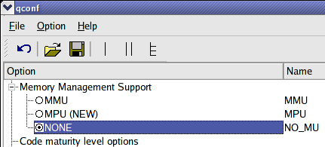
Disabling the MMU on CPUs with MMU
Kernel configuration option
Allows to disable the MMU
on some processors with
an MMU
(example: Samsung ones)
Not supported on x86
Check by yourself on your
own platform!

Slide 39
The uClinux-dist distribution
Not a binary distribution, but a tool and sources to build a root filesystem.
Contains application sources, patched for compliance with uClinux. 270 applications in user/ (including BusyBox) and 48 libraries in lib/, plus the uClibc source code.
Also includes kernel sources for a supported 2.2, 2.4 and 2.6 kernel versions (2.6.25-uc0 in uClinux-dist-20080808). This includes code for architectures not supported in the mainline kernel
(example: nios2nommu).
Example size (uClinux-dist-20080808):
Compressed archive (.tar.bz2): 281 MB!
Expanded archive: 1.5 GB!

Slide 40
uClinux-dist downloads
uClinux.org distribution
http://uclinux.org/pub/uClinux/dist/
For faster download time, can also use
http://sourceforge.net/projects/uclinux/download
Best places to find application sources for use with uClinux,
even if you don't use the distributions.

Slide 41
uClinux toolchains
Need to get uClinux specific toolchains
Toolchain locations are given on
http://uclinux.org/pub/uClinux/dist/
Regular toolchain (compiled to support PIC and XIP),
plus flat format utilities: elf2flt and flthdr.

Slide 42
Toolchain installation example
Arm example
Download the arm toolchain from http://ftp.snapgear.org/pub/snapgear/tools/arm-linux/
Extract the archive
cd /
sudo tar zxf arm-linux-tools-20070808.tar.gz
Caution: this one installs binaries
directly in /usr/local/bin!
Caution: old gcc 3.x toolchains are not relocatable!
They cannot be moved to another location
(unless you create links in the default location)

Slide 43
Compiling the uClinux distribution (1)
Add your uClinux cross-compiling toolchain to your PATH:
export PATH=path/bin:$PATH
(not needed with our toolchain in /usr/local)
Install the genromfs tool if you don't have it:
apt-get install genromfs (Debian / Ubuntu)
In the toplevel uClinux-dist directory:
make xconfig
or make menuconfig

Slide 44
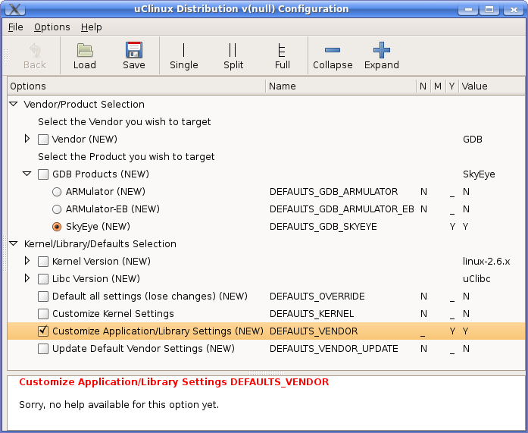
Compiling the uClinux distribution (2)
Choose your platform (vendor and product).
Choose your kernel
and C library version.
Customize or not
kernel and tool settings.

Slide 45
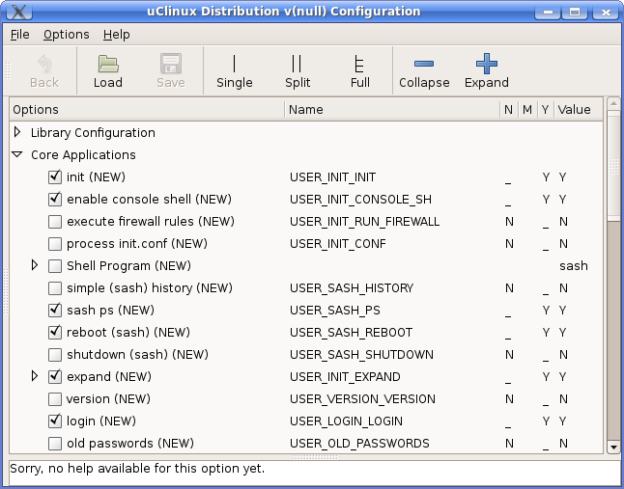
Compiling the uClinux distribution (3)
Other interfaces pops up
Configure your kernel
(if you chose this option)
Configure the user
tools (if you chose this option)
Compile:
make
This generates binary
images for your target
in the images/ directory.

Slide 46
Adding your custom application (1)
The easiest way is to add your application to uClinux-dist
Hello world example:
Create a user/hello directory in uClinux-dist
Create a user/hello/hello.c file:
#include <stdio.h>
int main() {
printf("Hello, world\n");
return 0;
}

Slide 47
Adding your own application (2)
Create user/hello/Makefile:
EXEC = hello
# Stack size (bytes)
FLTFLAGS += -s 64
all: $(EXEC)
romfs:
$(ROMFSINST) /bin/$(EXEC)
clean:
-rm -f $(EXEC) *.elf *.gdb *.o
See other Makefile examples in the user/ directory.

Slide 48
Adding your custom application (3)
Declare your application somewhere in user/Kconfig:
(for example in Miscellaneous Configuration)
config USER_HELLO
bool "Hello world program"
help
A sample C program
Add the below line to user/hello/Makefile:
dir_$(CONFIG_USER_HELLO) += hello
Run make menuconfig or make xconfig and enable your new application.
Run make to compile your application
and add it to your filesystem image.

Slide 49
Summary
Worthy to use uClinux (rather than a proprietary RTOS)
on processors without an MMU. Surprisingly, with uClinux, there are only minor differences with what you can do with a full Linux kernel.
In some cases, worthy to use uClinux rather than Linux on processors with an MMU, for performance reasons.
Though a lot of work has already been done and most applications have already been ported, some uClinux experience or learning is definitely needed when you start a new project.

Slide 50
Resources
uClinux, State Of The Nation, by Greg Ungerer (Apr. 2007)
http://www.linuxdevices.com/files/article078/uclinux-sotn.pdf
uClinux development mailing list
https://mailman.uclinux.org/mailman/listinfo/uclinux-dev
Archives: http://mailman.uclinux.org/pipermail/uclinux-dev/
http://ucdot.org/
A wealth of resources, FAQs, forums for uClinux developers!
Don't miss the very complete FAQ:
http://www.ucdot.org/faq.pl

Slide 51


Free alternatives to uClinux
eCos: http://en.wikipedia.org/wiki/ECos
Lightweight real-time embedded system,
originally contributed by Red Hat / Cygnus solutions.
FreeRTOS: http://en.wikipedia.org/wiki/FreeRTOS
Another free RTOS, gaining popularity over eCos
in the last years. Apparently, eCosCentric seems
to put more focus on their proprietary extensions.
Both also support 16 bit processors
(not supported by uClinux and Linux)

